Slide 1



Practical rendering of detailed neuron simulations
Juan B. Hernando¹, John Biddiscombe², Bidur Bohara³, Stefan Eilemann³ and Felix Schüermann³
¹Cajal Blue Brain (CeSViMa – UPM), Spain ²CSCS, Swiss National Supercomputing Center, Switzerland ³Blue Brain Project (EPFL), Switzerland
EGPGV, May 2013, Girona

Slide 2
Outline
Background: The Blue Brain Project
Simulating detailed cortical tissue
Motivations
Proposed solutions:
RTNeuron
Paraview + extensions
Experimental results

Slide 3
The Blue Brain Project
The Blue Brain Project is the first attempt to systematically reverse engineer the human brain.
The goal is to build a facility in which simulation based research can be conducted to study the function and dysfunction of the brain.

Slide 4
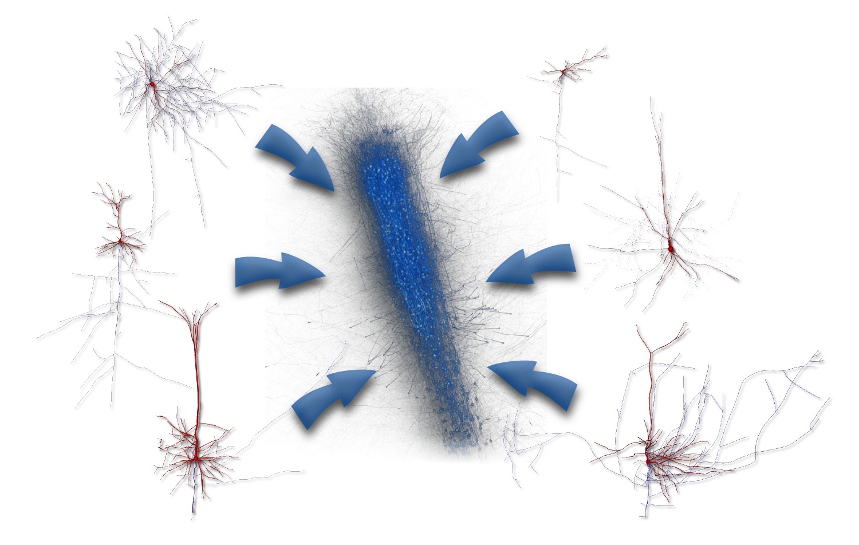
Simulating detailed cortical tissue

Slide 5
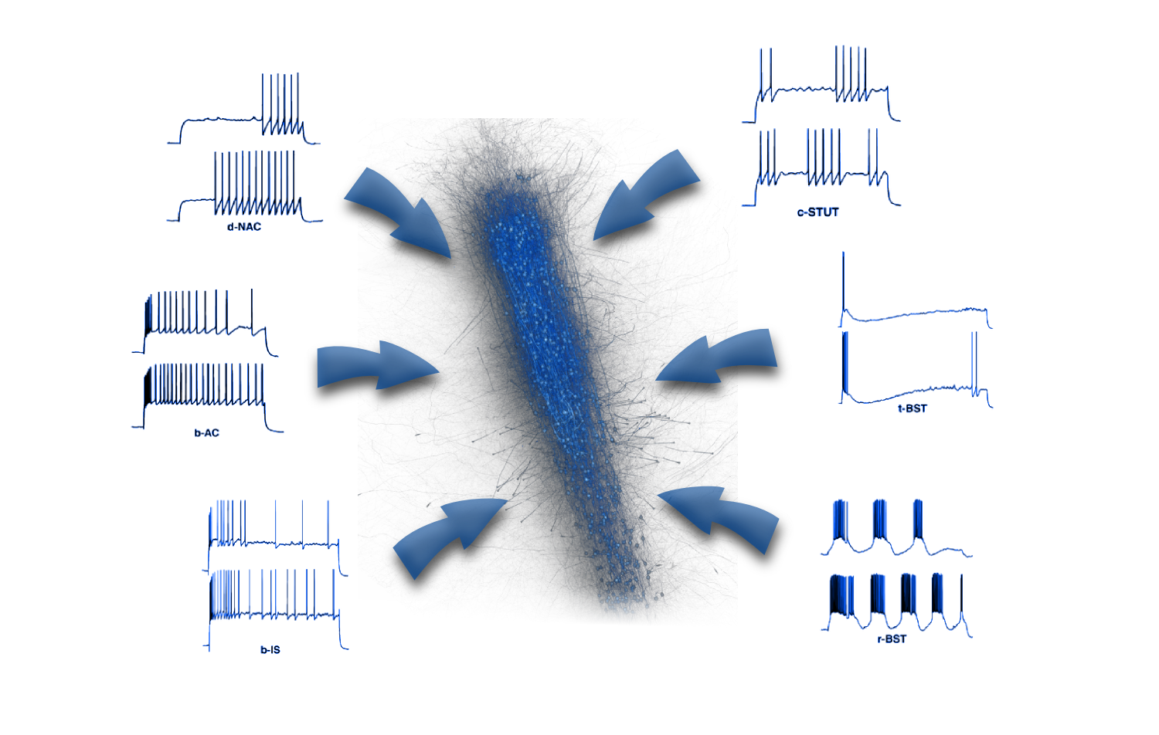
Simulating detailed cortical tissue

Slide 6
Motivations
Analysis bottleneck:
Simulations can produce huge amounts of data (+100 GB for 10K neurons, 1 s biological time, single variable reported at 0.1 ms intervals)
Scientists require flexible interactive exploratory visualization (> 10 fps for simulation playback)
Visual complexity
Complex and entwined geometry.
Transparency for focus+context visualization.
Rendering complexity
Geometrical workload: >4,000 segments (from the reconstructions), ≈150,000 triangles
uncommon aspect ratio.
sub-pixel geometry.

Slide 7
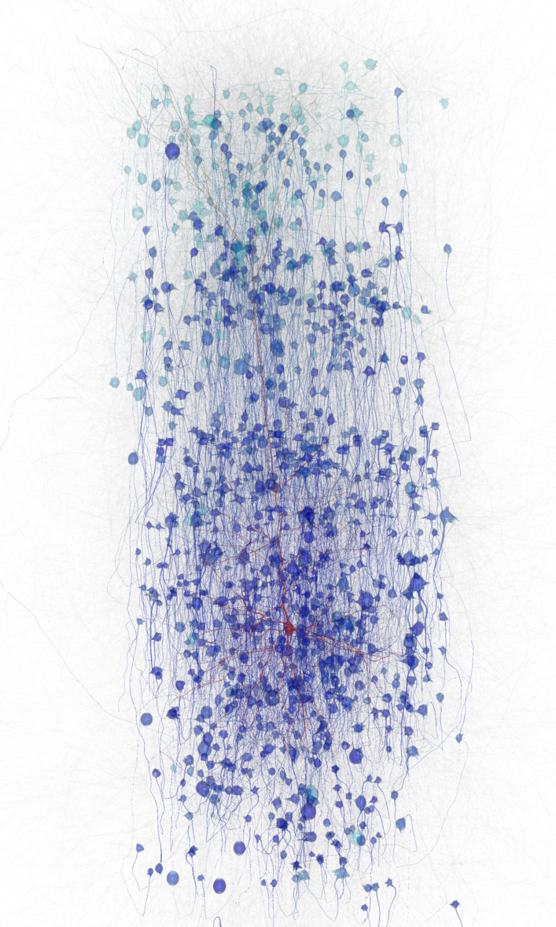
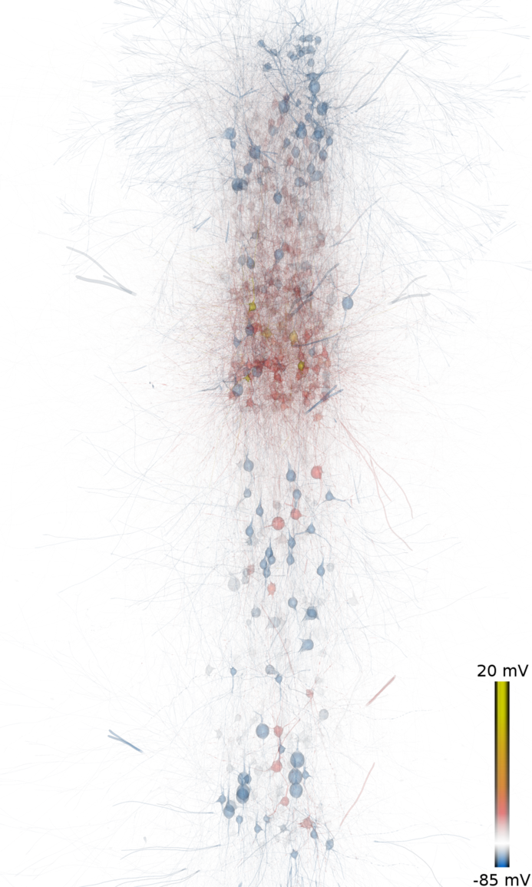

Slide 8
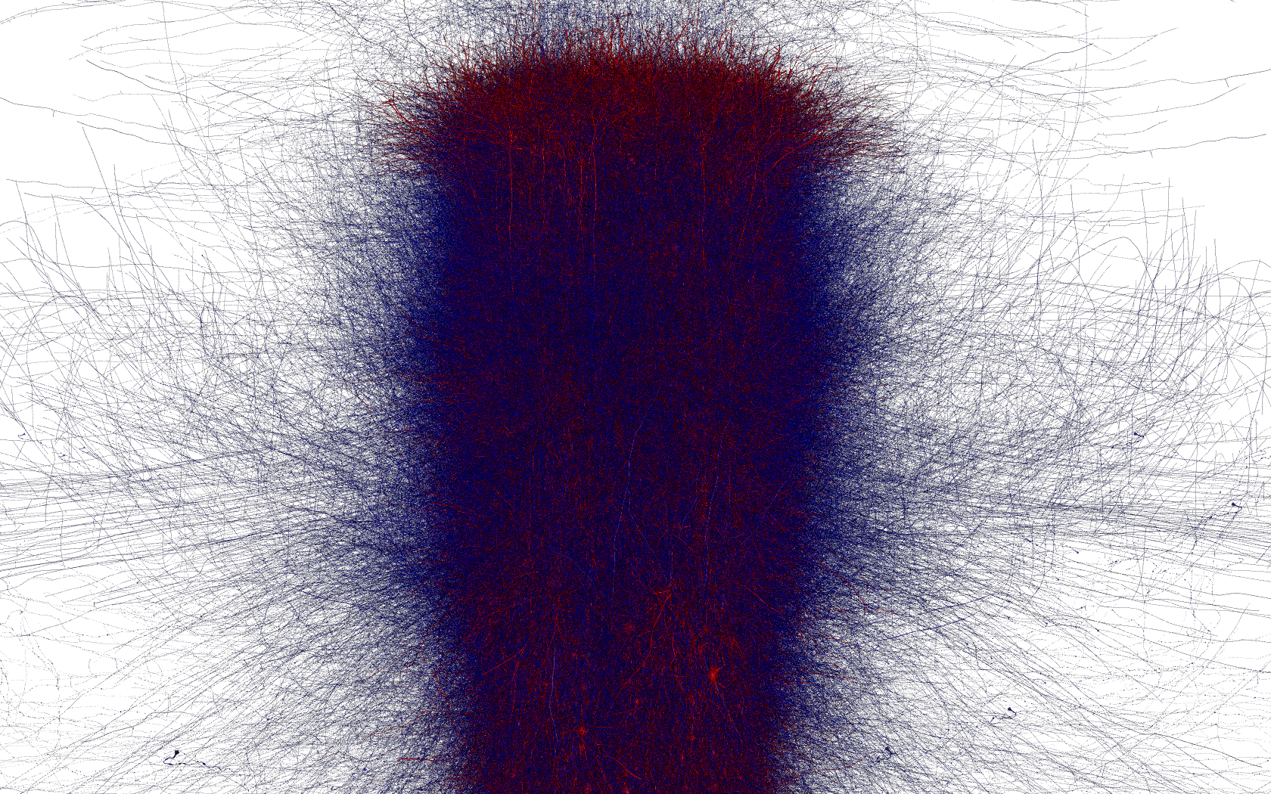
Notes:
And this is how it looks like without transparency

Slide 9
Motivations
Rendering complexity plus interactivity force to use parallelism to achieve the desired performance
There are 2 choices:
Develop a custom solution.
Reuse and adapt a readily available tool.
We have implemented and compared both.
Notes:
Simplification and visual abstraction of the scene is another alternative, but we want to have the capability of showing the circuit “as is” during the exploratory analysis of a simulation.

Slide 10
Ad hoc solution: RTNeuron
Based on Equalizer for parallel rendering
Features:
On-membrane scalar variable visualization.
Spike visualization.
LODs.
Dual depth peeling for transparency.
Sort-firt, sort-last.
Accumulation-based anti-aliasing when idle.

Slide 11
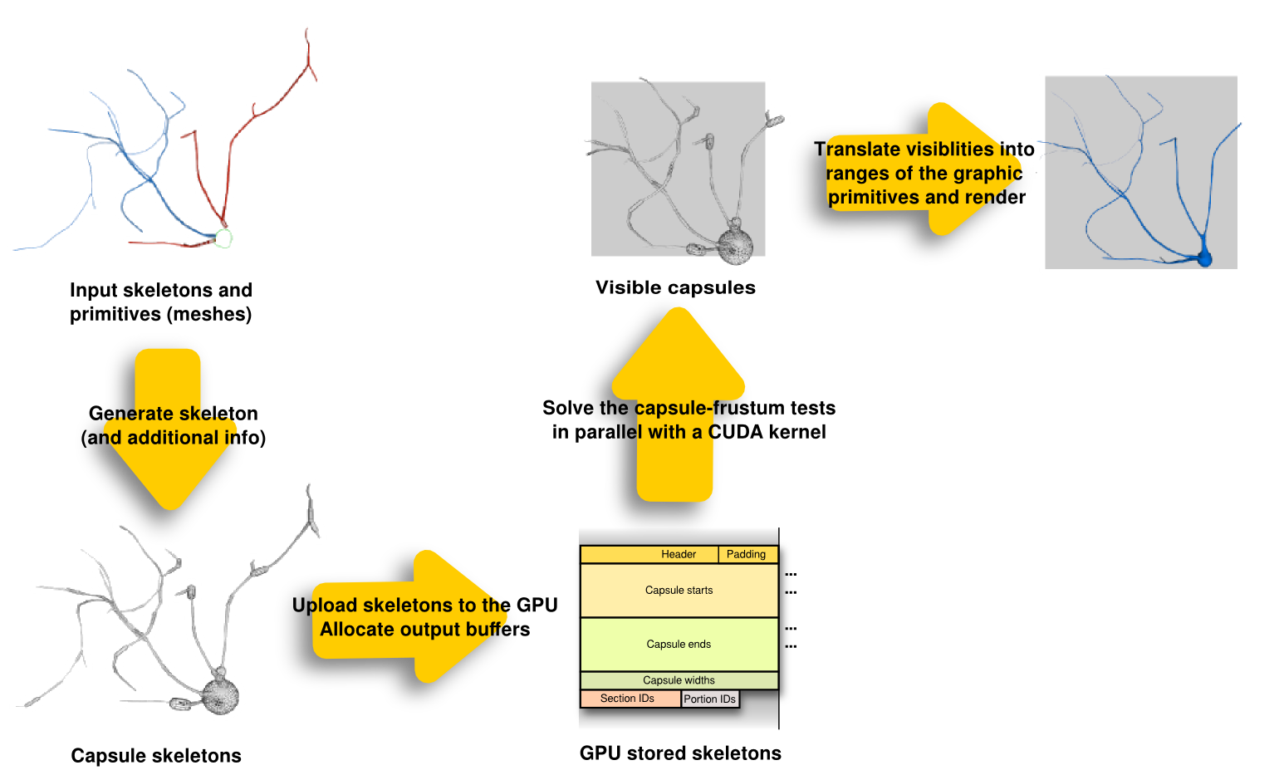
RTNeuron: sort-first
Capsule skeleton-based view frustum culling executed in the GPU.
[Towards real-time visualization of detailed neural tissue models: view frustum culling for parallel rendering
Hernando et al, BioVis 2012]

Slide 12
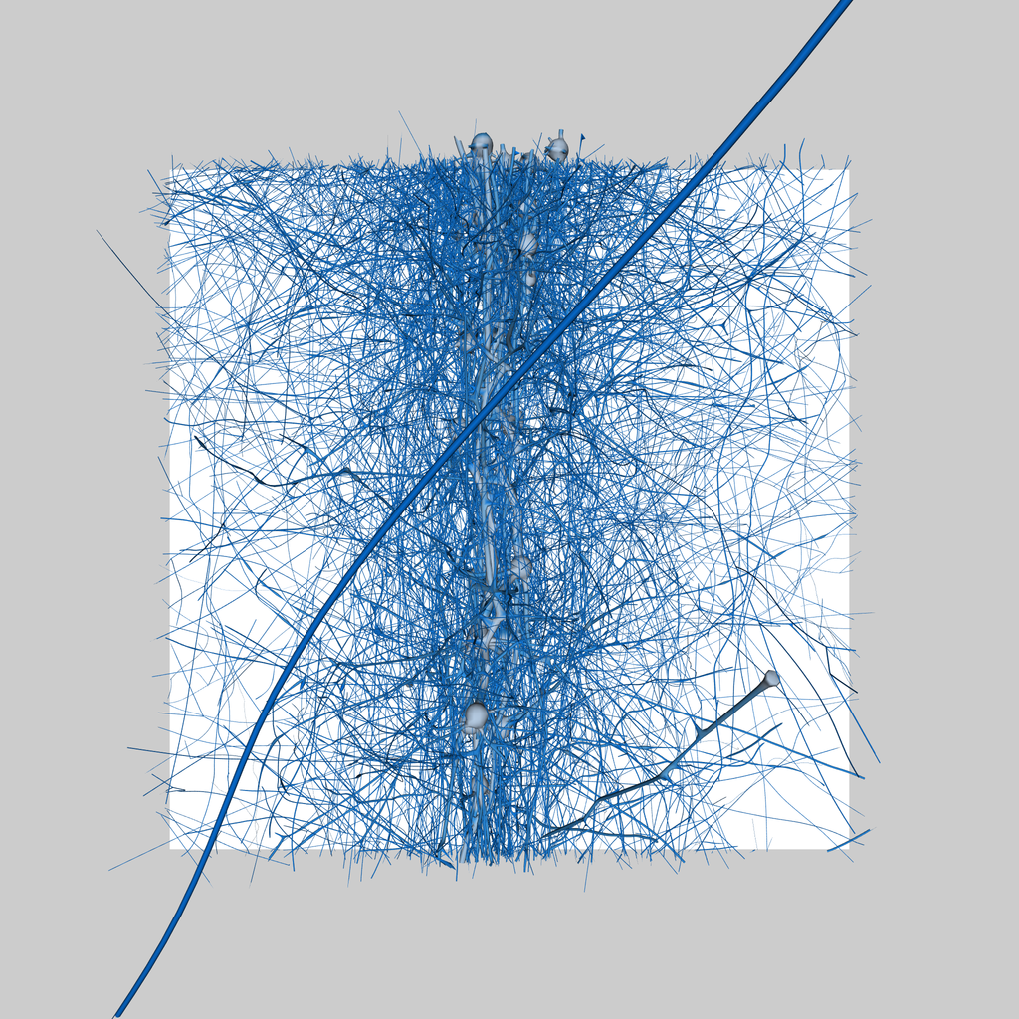
RTNeuron: sort-first

Slide 13
RTNeuron: sort-last
Balanced kd-tree partition of the scene.
Each node builds only a portion of the tree.
View frustum code is reused to soft clip the meshes to the leaf box. If neuron geometries are unique the meshes can be hard clipped.
An OpenGL clip plane is set up for each leaf face.
Direct-send is used for parallel compositing of the final image. Z-buffer not transferred, only the compositing order.

Slide 14
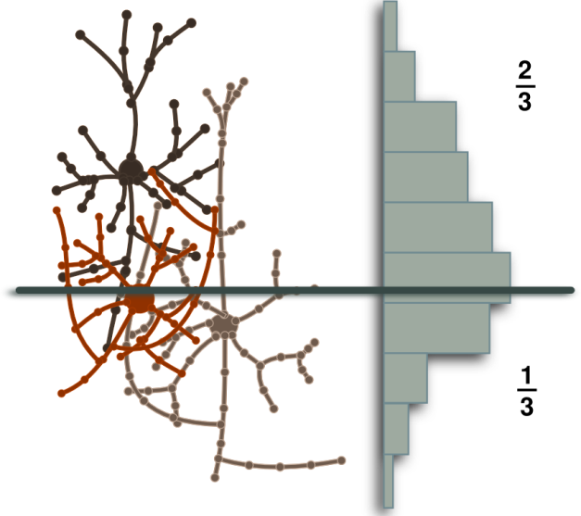
RTNeuron: sort-last
The k-d tree is built combining skeletal and mesh information.
Notes:
The advantage of using the skeletons is that we can annotate the weights beforehand than then we don’t need to load the meshes, thus accelerating the loading phase.

Slide 15
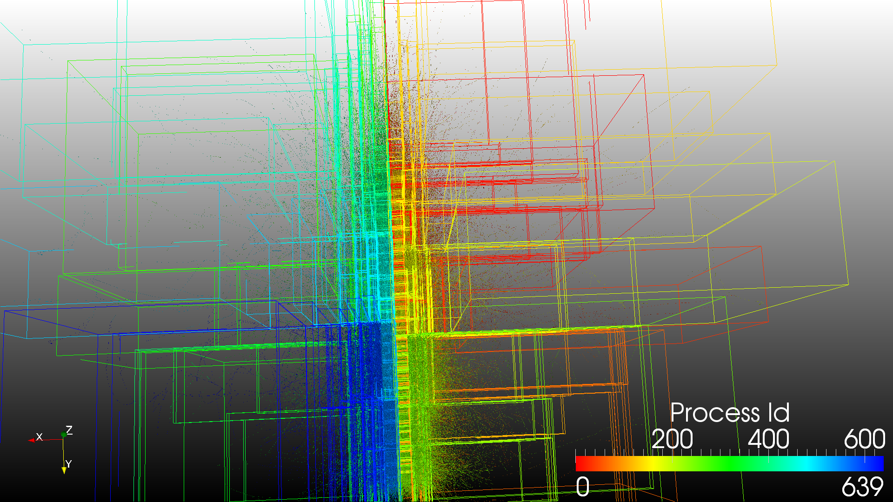
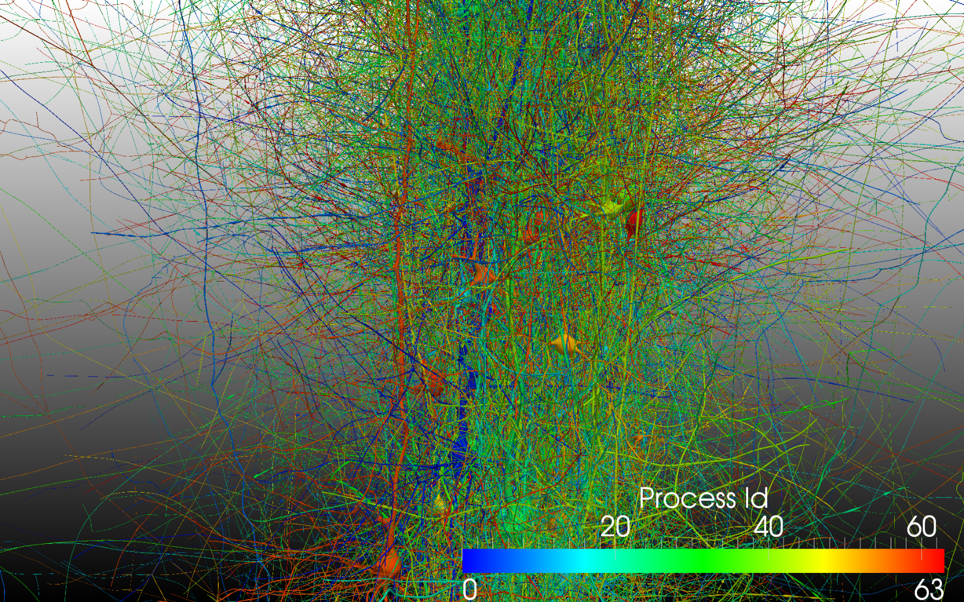
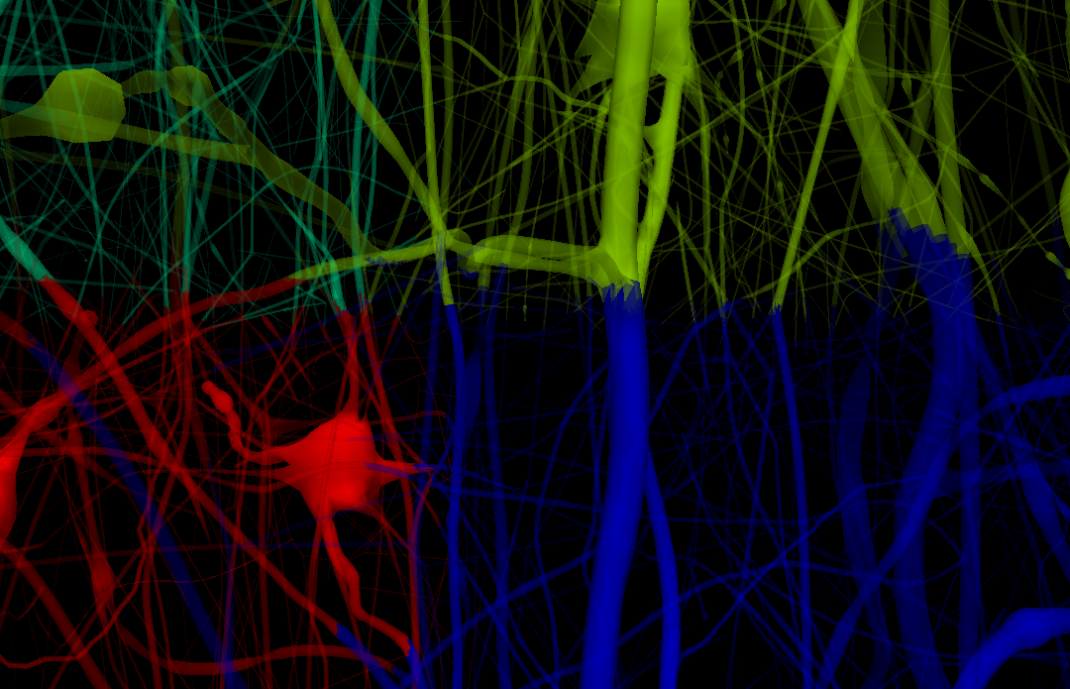
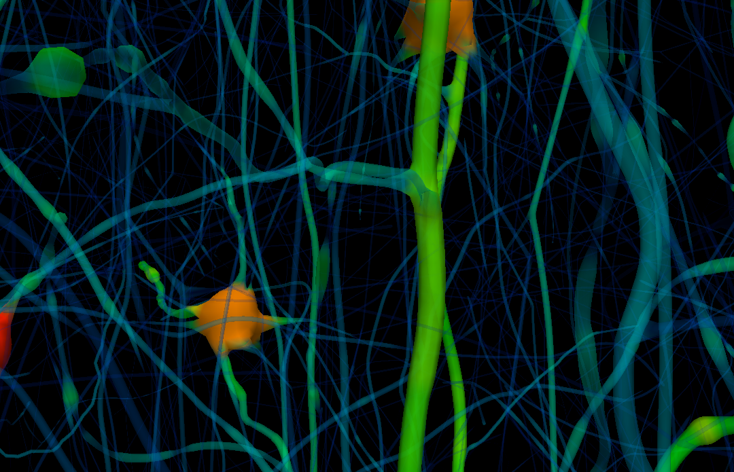
Off-the-self solution: ParaView
Neurons loaded, divided randomly amongst processes (to avoid layer imbalances)
Entire mesh partitioned using custom vtk+zoltan filter (NB. not neuron specific)
Each process renders piece using back to front depth sort
Final image composited in back-front ordered using node order KdTree
Mesh Partition Filter
Depth Sort
Painter
Compositor
KdTree
Passed via Extent Translator Information Key down pipeline

Slide 16
ParaView Implementations
CPU
Mappers : DepthSort (generates indices),
PolygonMapper (renders by index)
GPU
Piston Mapper (thrust),
Compute distance (thrust::for_each)
Depth sort - thrust:: sort_by_key
Pass arrays directly to vtkgl::BindBuffer (&etc …)

Slide 17
Experimental setup
10,000 neuron circuit with 1.4 × 10⁶ triangles. 3 subcircuits for strong scaling: 1,000 neurons (14.5 × 10⁶ tri) 2,000 neurons (30 × 10⁶ tri) and 5,000 neurons (720 × 10⁶ tri).
Two viewpoints (full view, close up) with opaque and transparent geometry, 1920 × 1200 resolution.
GPU accelerated rendering: Fat-node cluster (up to 6 nodes):
Dual six-core 3.47GHz processors (Intel Xeon X5690)
24 GB RAM
3 GeForce GTX 580 each
40 Gb/s QDR Infiniband interconnect
CPU only rendering: Cray XK7, 272 nodes of 2.1Ghz 16-core AMD Opteron.

Slide 18
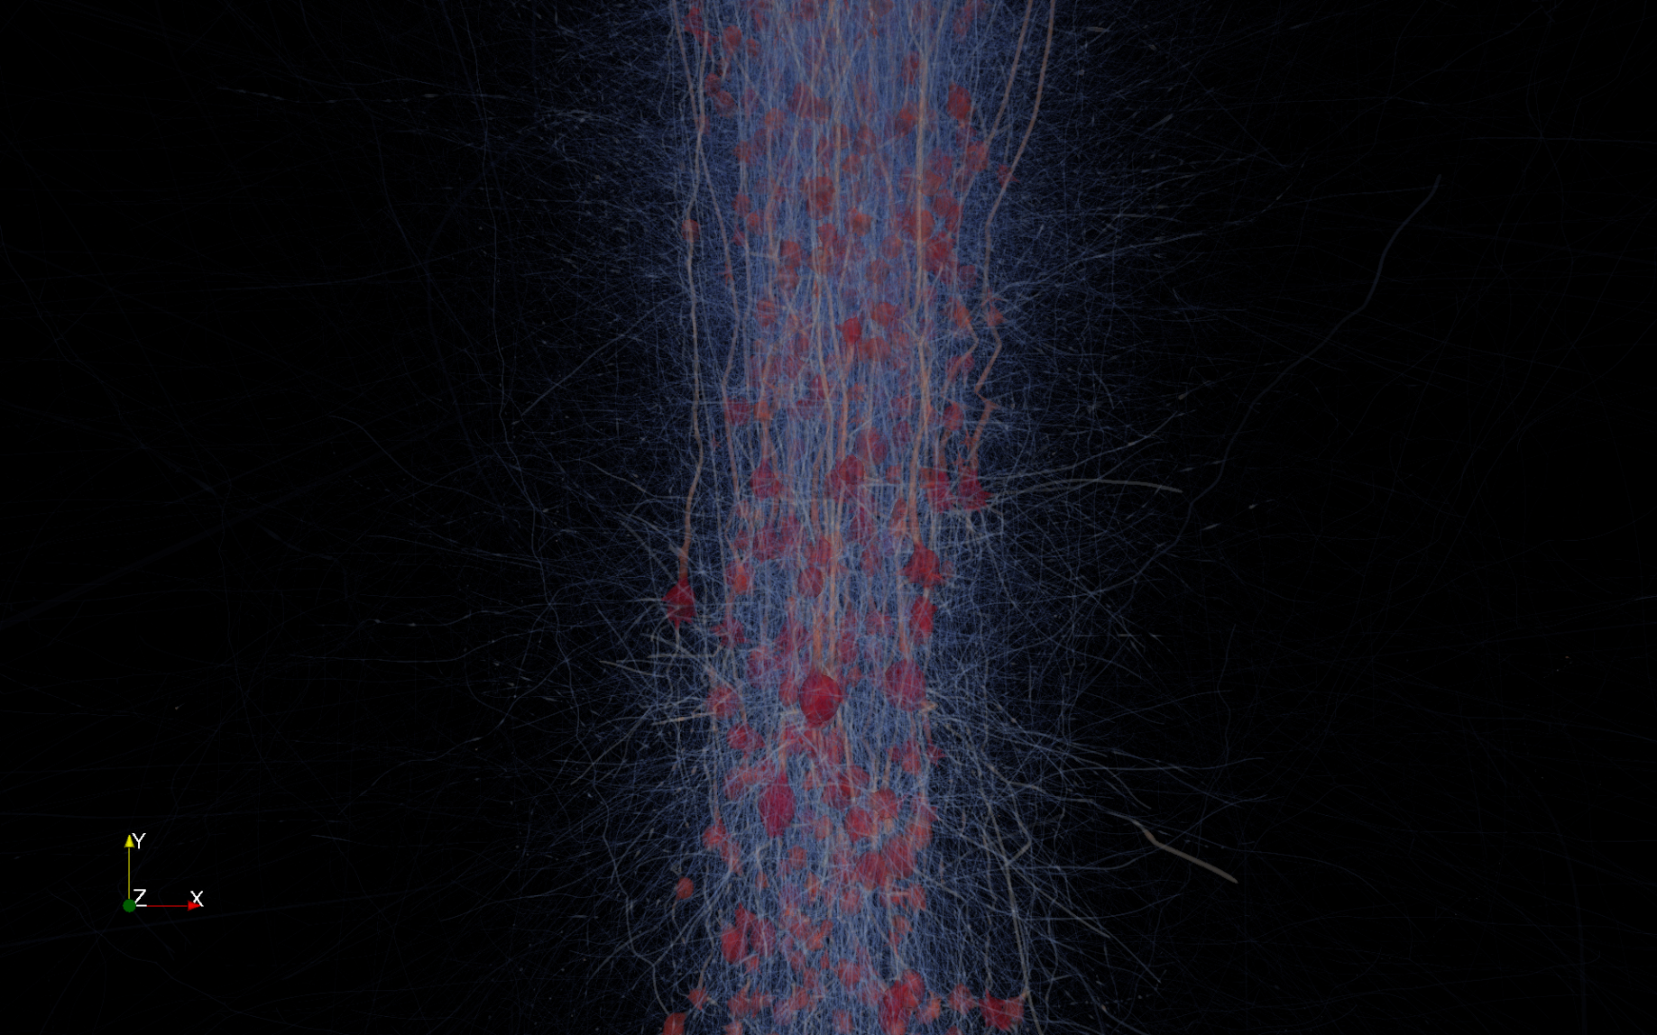
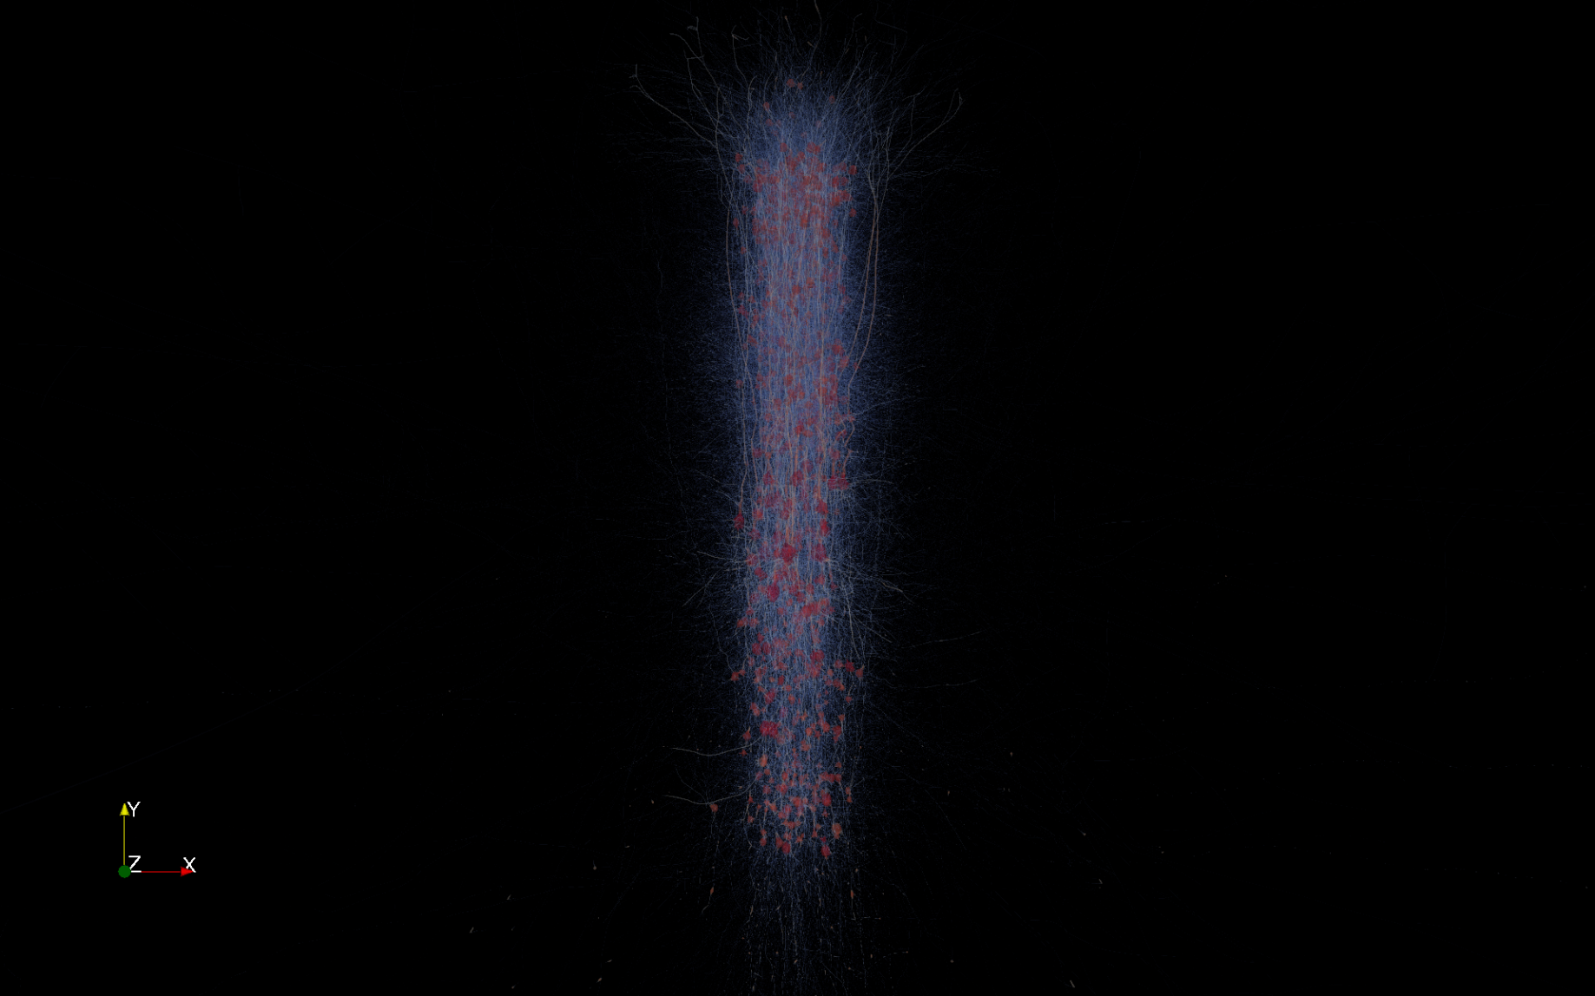
Rendered views

Slide 19
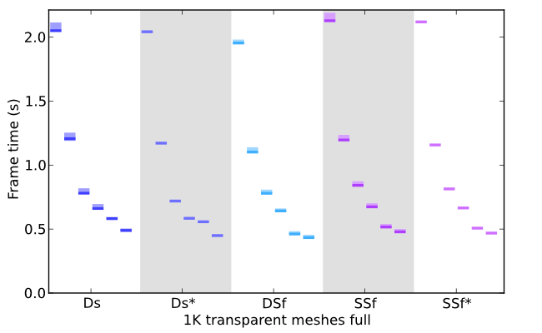
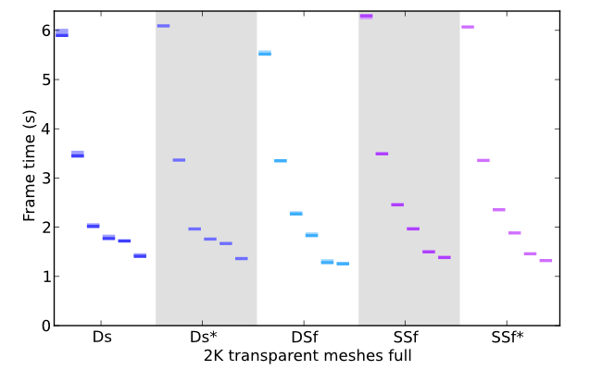
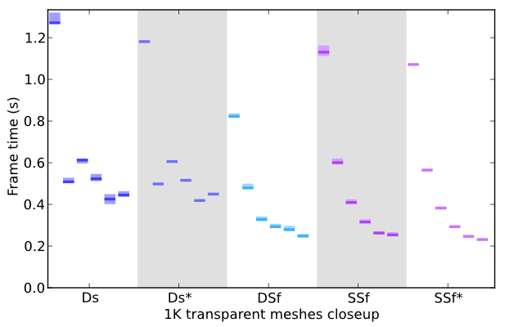
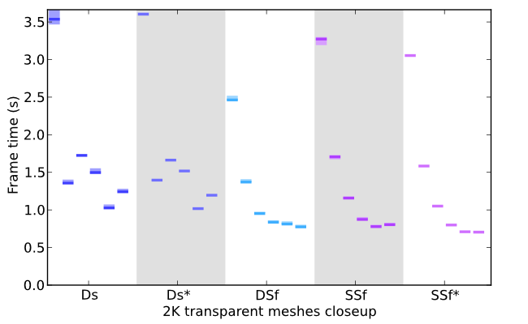
Strong scaling in RTNeuron

Slide 20
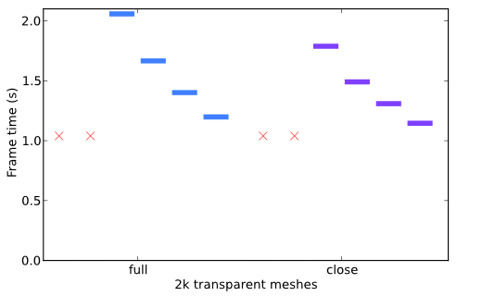
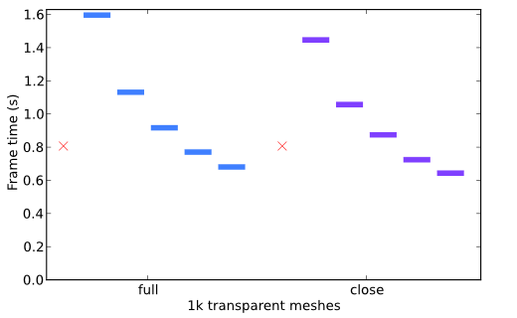
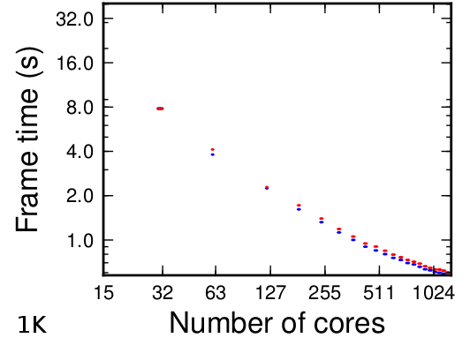
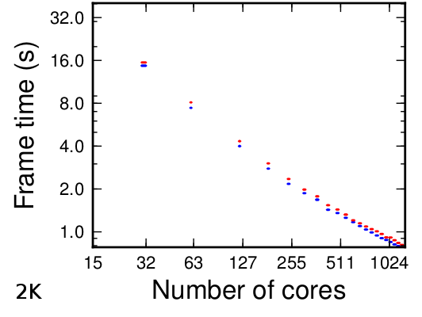
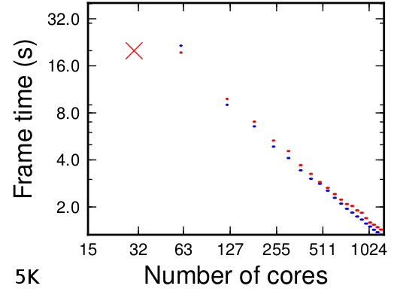
Strong scaling in Paraview
GPU acceletered rendering
CPU only rendering

Slide 21
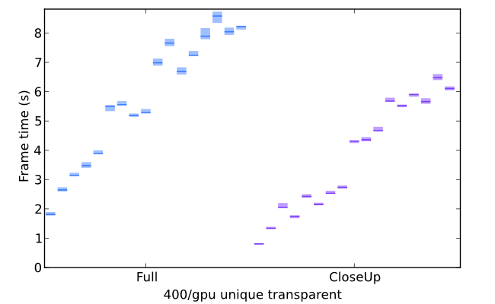
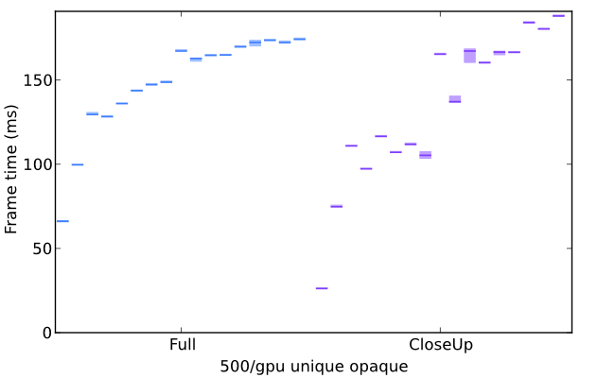
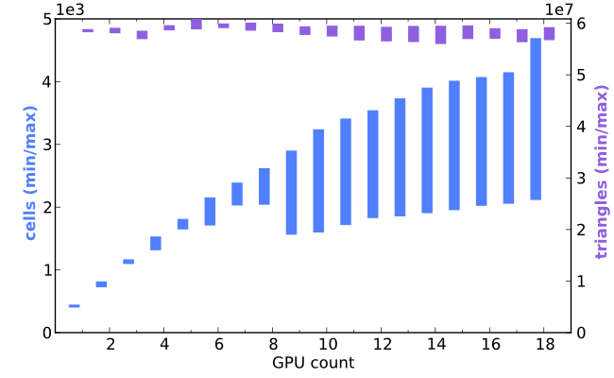
Weak scaling in RTNeuron

Slide 22
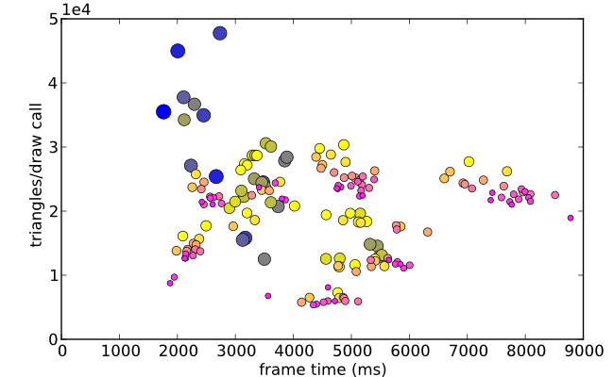
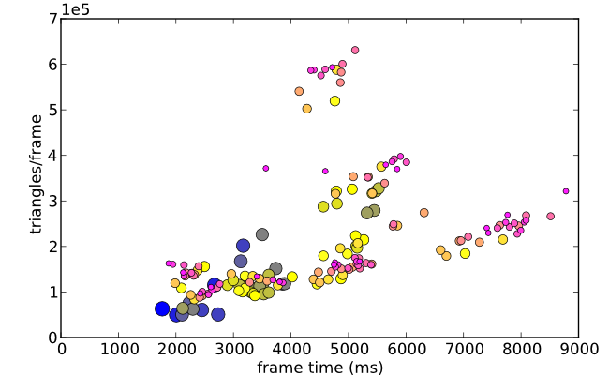
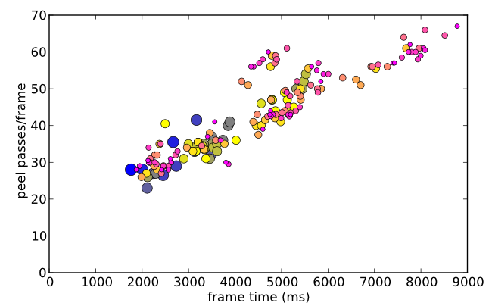
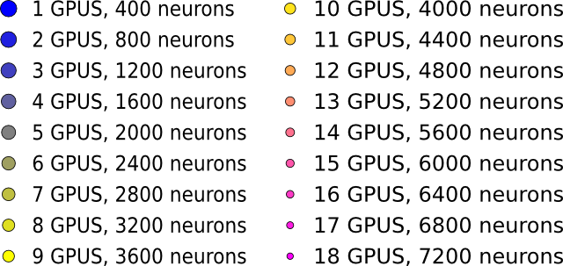
Weak scaling in RTNeuron
400 neurons ≈ 5.6 × 10⁶ triangles

Slide 23
Conclusions
RTNeuron
Paraview
Pros
Slighty faster.
Better performance in close ups (thanks to VFC).
More flexible.
Faster pre-processing time.
Cons
Less scalable.
Non trivial implementation .
Pros
Simpler implementation
Very good scalability in CPU rendering mode
Cons
Close up rendering less efficient due to the order between VFC and sorting steps.

Slide 24
Future work
RTNeuron
Sort-first like partitions in z-axis to reduce depth complexity.
Dynamic load balancing in sort-last.
Predictive dynamic sort-first.
Improve transparency rendering in a single GPU.
Paraview.
View frustum clipping before sorting.
Fixing sorting artifacts.

Slide 25
Questions?

